Slide 1



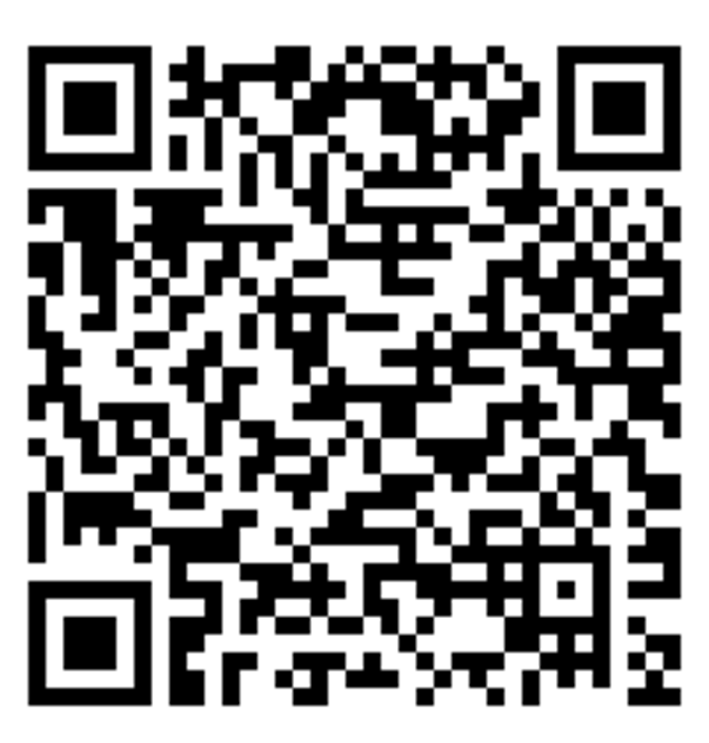


Development Notice
[Type of Application]
A change is proposed for these lands located at XX Planning St. & XX Design Blvd.
The City received an application to amend the Official Plan and Zoning By-Laws to allow for new development in this community. Updated policies will permit a mixed-use development with retail, residential and office uses.
Insert Image
XX Storeys XX Meters
XXX Units
XX m² Retail (XX sf.)
APPLICANTS PROPOSAL MONTH DAY YEAR
Tell us what you think:
CITY PLANNING
Planner’s Name
905.XXX.XXXX | email@markham.ca
Public Meeting
Information will be posted on this sign when available.
CLERK’S OFFICE
notifications@markham.ca
PLAN - YY - XXXXXX
To learn more, visit:
Disclaimer: The above represents the applicant’s proposal at the time this notice was prepared and is subject to change

